Slide 1
Lecture 11: Open Loop Control of Actions
The two problems with action control
The problem with DF
The problem with CCV:
Inverse dynamics and inverse kinematics – poor adaptability
Muscle state/architecture – same neural command results in different muscle force
Inherent dynamics of muscles/joints
Incidental dynamics

Slide 3
Two elements of action control
The function of perception is to control action
Two elements in action control:
Coordination: organize various parts of an action system (e.g. the neural systems, muscles, tendons, joints, bones etc.)
Control: regulate the action system to achieve a task goal

Slide 4
Why is it hard to make a robot play chess?
Make a robot to ”think” of the next moves – easy(?)
Make a robot to place chess pieces – not so easy
Coordination: how to pick up a chess piece, and put it down at a precise point while scratching chin with the other hand?
Control: how to avoid knocking over other chess pieces (of different sizes and locations), or locate the target location while some board grids are occluded.

Slide 5
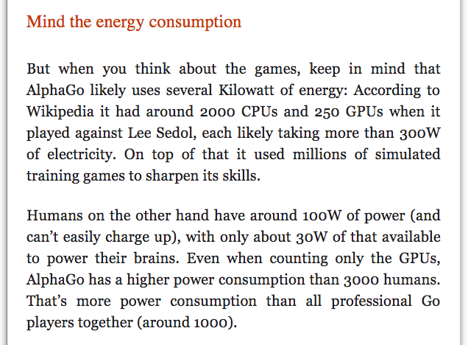

Slide 6
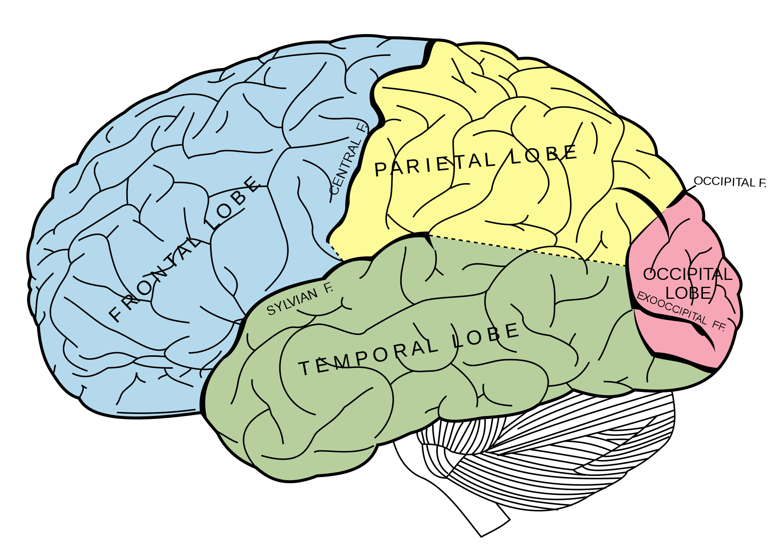
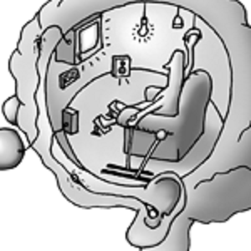
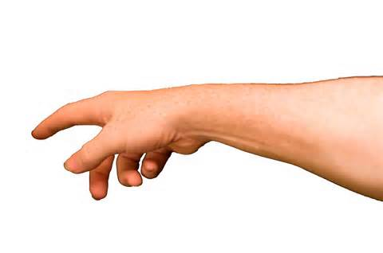
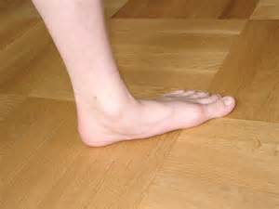
How are actions controlled? – Past ideas
Input: Sensory info,
vision, audition, touch
Output: Motor commands, to move muscles, bones or joints
The traditional way of thinking

Slide 7
Open loop control
Open loop control: the central executive sends commands to moving body parts. Everything is pre-programmed, no feedback
Only efference (motor commands sent from the CNS to the moving body parts)
No afference (feedback info sent from the moving parts to the CNS)
Brain dominant

Slide 8
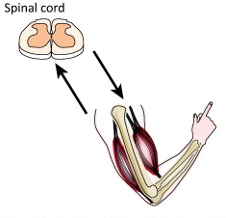
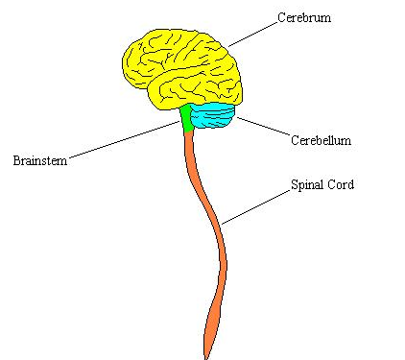
Open loop control theories: The CNS sends out a motor command (efference), and keeps a copy of the motor command (efference copy) so that the actor knows what she has done and hence controls her actions.
efference
afference

Slide 9
Problems with open loop control
Nikolai Bernstein (1896 – 1966)
Russian physiologist
Translated in 1967, large influence in the West since 1980s (Turvey, 1977)
Bernstein’s problems:
Degrees-of-freedom problem (DF)
Context-conditioned variability problem (CCV)

Slide 10
The DF problem
DF = number of values required to specify the state of the system (e.g. number of motor neurons, or positions of all joints)
How to control a system with many moving parts?
The central executive cannot control them independently
The same task goal can be achieved by different movements…even more DFs.
How to constrain them to yield a unique movement?

Slide 11
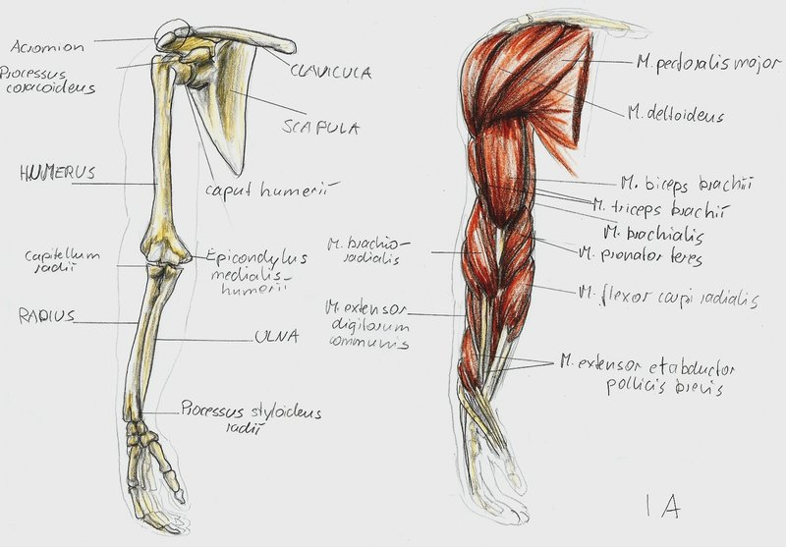
The DF problem
Say the brain sends motor commands to the “movement units” in an arm to perform a reaching task
Movement unit | DF’s
Motor neurons | ~ 2600
Muscles | Total: 26 Shoulder = 10 Elbow = 6 Wrist = 6 Radial ulnar = 4
Joint | Total: 7 Shoulder = 3 Elbow = 1 Radial-ulnar = 1 Wrist =2
The burden on the central executive increases exponentially because the DF’s interact!!

Slide 12
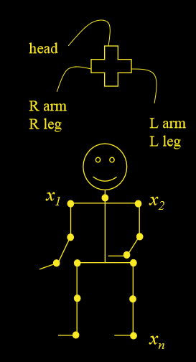
Berstein’s solution: Synergy
How to control a system with many DF’s?
Coupling – couple low-level DFs to form automatisms
“Synergy”
Notes:
4 wheels of a car– fix the front 2 and the rear 2. move the front 2 together and the rear 2 follow (or vice versa). DF reduces from 4 to 1.
The match-man: instead of controlling each joint, control the left arm as one unit, the right arm as one unit etc..

Slide 13
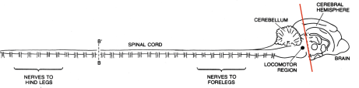
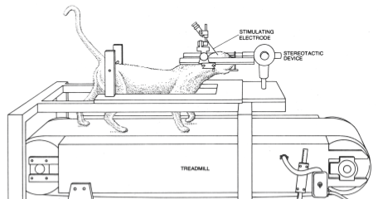
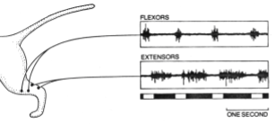
Automatism example: “lower level” performance
Brown (1911):
Decerebrate a cat. Put cat on a moving treadmill. Cat “walked”.
Stimulate brain stem. Increased walking speed, gait transition appeared.
Gait control is not in the cerebral cortex… lower level… spinal cord

Slide 14
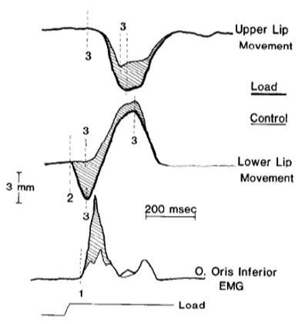
Automatism example 2: compensation
Gracco & Abs (1985):
While saying “aba”, perturb lower lip, upper lip quickly (50ms) adapts to complete the sound.
Coupling DFs to achieve the functional goal.

Slide 15
How does coordination or synergy form?
Hypothesis 1: the central executive
There exist some action plan, motor program or central (=neural) pattern generators (CPG) that are known to and controlled by the central executive.
Hypothesis 2: self-organization, emergent behavior
Organizations emerge (with no prior rules) from processes of pattern formation

Slide 17
The CCV problem in movement control
Kinematics: position, velocity, acceleration, path trajectory…
Dynamics: force, mass, inertia…
(1) Indeterminacy: movement control involves kinematics and dynamics. If movements are controlled open-loop (pre-planned), then the CNS has to know the movement goal and uses:
Inversed kinematics: the brain first plans out a desired trajectory for the hand and limb geometry and then computes the joint trajectory
Inversed dynamics: given the desired joint trajectories and the limb dynamics (e.g. inertias), compute the joint torques
Adaptability: What happens when there is a sudden change in the environment?

Slide 18
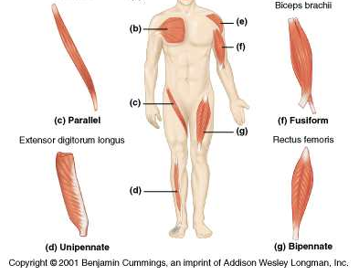
The CCV problem in movement control
(2) Equifinality: The brain’s commands activate muscles but the resulting muscle force depends on more factors
Force depends on, for example, muscle state (fatigue, blood circulation etc.) and muscle architecture.
Muscle architecture:
Parallel (fast, long lasting and weaker)
Pennate (strong, slow and fatigued faster)

Slide 19
The CCV problem in movement control
(3) Equifinality: A movement depends on muscle force and force environment.
Force environment: muscles, inertia (limb mass), gravity (limb weight), interactive force/torque (link segment), friction (e.g. move in water), other objects (e.g. holding a slippery eel, or dancing with a partner).
Inherent dynamics of a limb/joint
Notes:
e.g. push a person, the person falls; but with the same force, push a wall = nothing

Slide 20
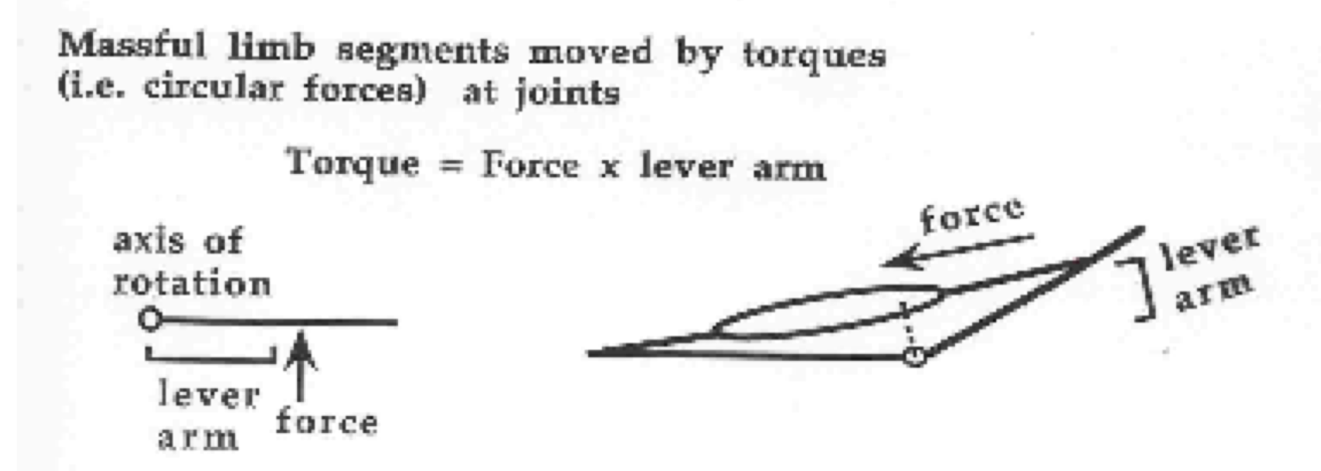
The CCV problem in movement control
(3) A movement depends on muscle force and force environment.
Inherent dynamics
Muscles produce force;
but joints are moved by torques
Force is affected by limb/joint position

Slide 21
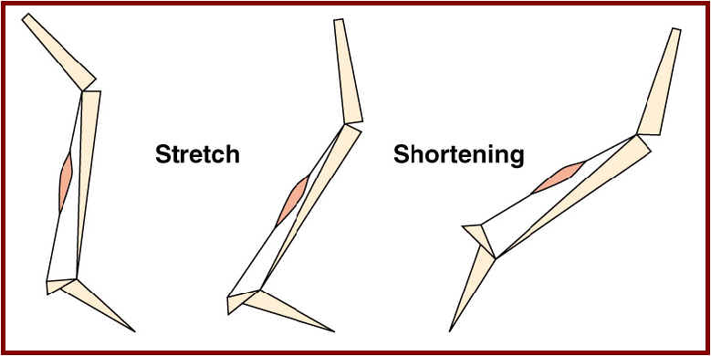
Muscle lengths and joint positions

Slide 22
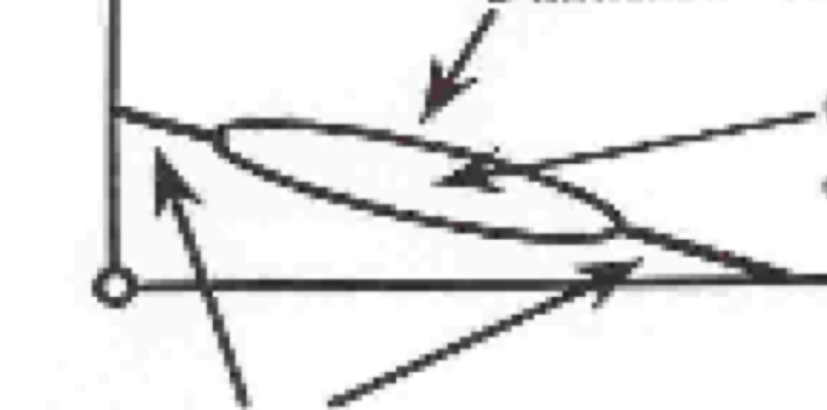
The CCV problem in movement control
(3) A movement depends on muscle force and force environment.
Inherent dynamics
Force is affected by limb/joint position
Parallel elastic sheath
Three components of a muscle, 2 passive and 1 active
Contractile component
Total force (tension) = active + passive
Series elastic (tendons)

Slide 23
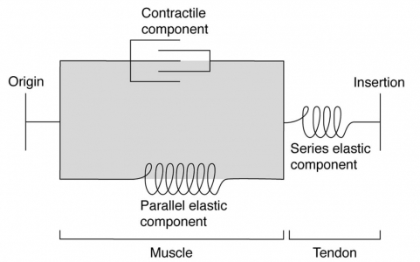

Slide 24
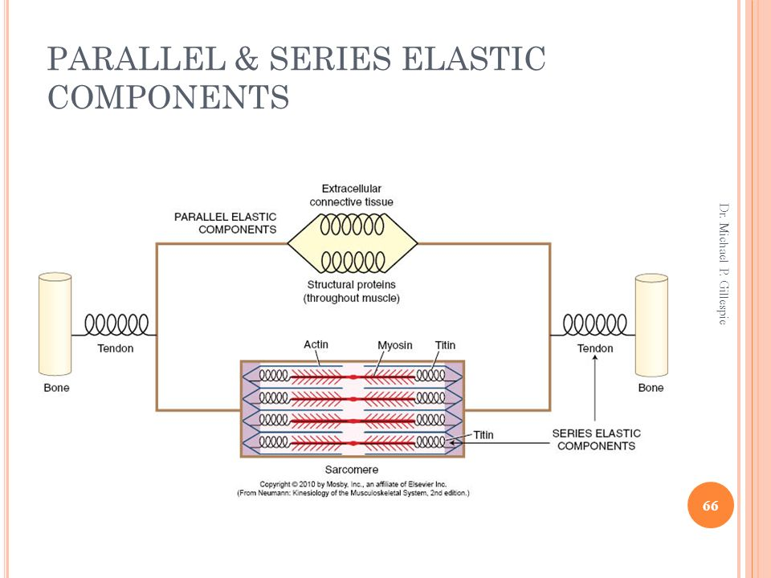

Slide 25
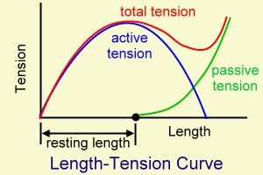
The CCV problem in movement control
(3) A movement depends on muscle force and force environment.
Inherent dynamics
Force is affected by limb/joint position
Parallel elastic sheath
Contractile component
Series elastic (tendons)
Three components of a muscle, 2 passive and 1 active
Total force (tension) = active+ passive

Slide 26
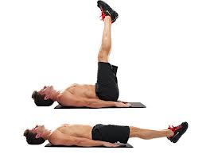
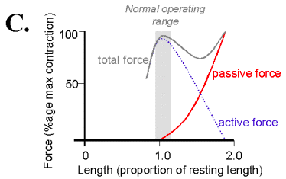
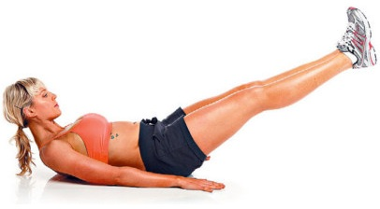
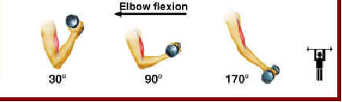
The CCV problem in movement control
(3) A movement depends on muscle force and force environment.
Inherent dynamics
Non-linear

Slide 27
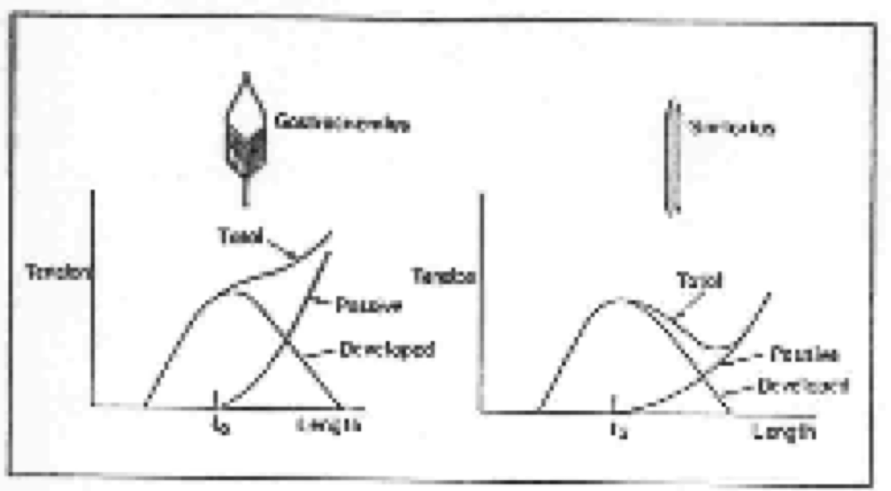
The CCV problem in movement control
(3) A movement depends on muscle force and force environment.
Inherent dynamics
Force is affected by limb/joint position
pennate
parallel
The length-tension relations are different for different muscle architectures.

Slide 28
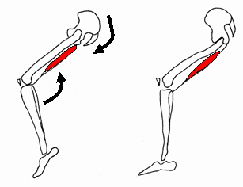
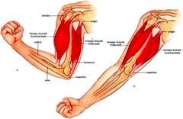
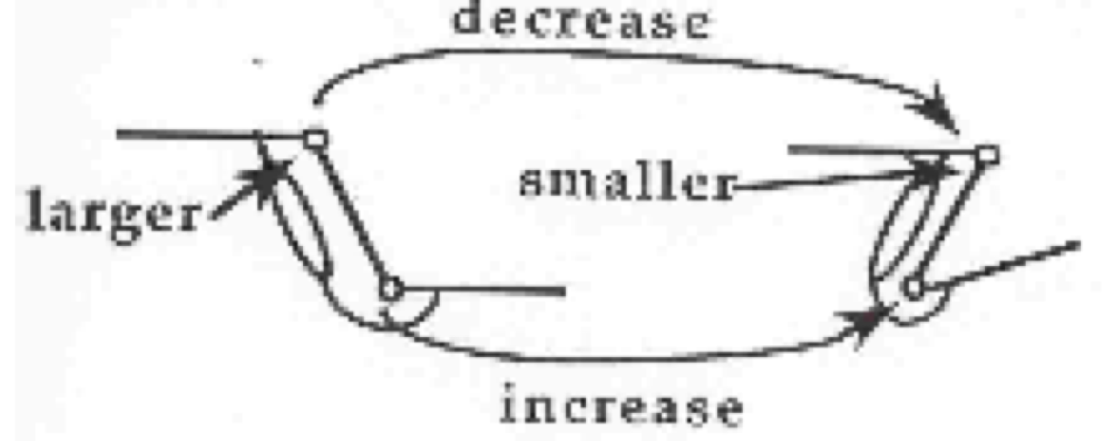
The CCV problem in movement control
(3) A movement depends on muscle force and force environment.
Inherent dynamics
Force is affected by limb/joint position
Two joint muscles: co-vary joints inversely, total muscle length stays the same, force output is different

Slide 29
The CCV problem in movement control
(3) A movement depends on muscle force and force environment.
Inherent dynamics
Force is affected by limb/joint position: Summary
For a given level of neural activation, force from a muscle varies depending on muscle length, according to the nonlinear length-tension curve.
The L-T curve is different for different muscle architectures.
Muscle length is not one-to-one with joint position, e.g. 2-joint muscles.
Lastly, torque at a joint = muscle force X lever arm and lever arm varies with joint position.
Therefore, action of muscle depends on joint position and which muscle to use for a given movement depends on the circumstance.
Neural activation ≠ muscle force
Notes:
e.g. push a person, the person falls; but with the same force, push a wall = nothing

Slide 30
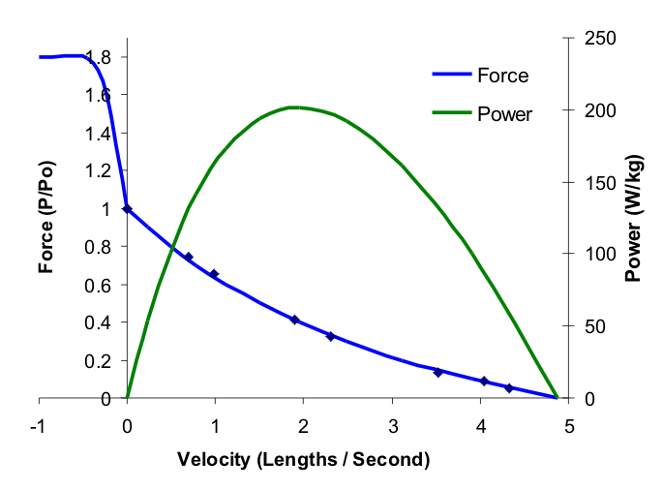
The CCV problem in movement control
(3) A movement depends on muscle force and force environment.
Inherent dynamics
Nonlinearity pervades inherent dynamics!!! So, cannot predict the behavior of the whole system from knowledge of the behavior of the components.
Force is affected by limb/joint velocity
Force-velocity curve
Power of a moving muscle: rate at which energy is liberated
Power = force X velocity
Optimal at 1/3 max vel
Potentiation

Slide 31
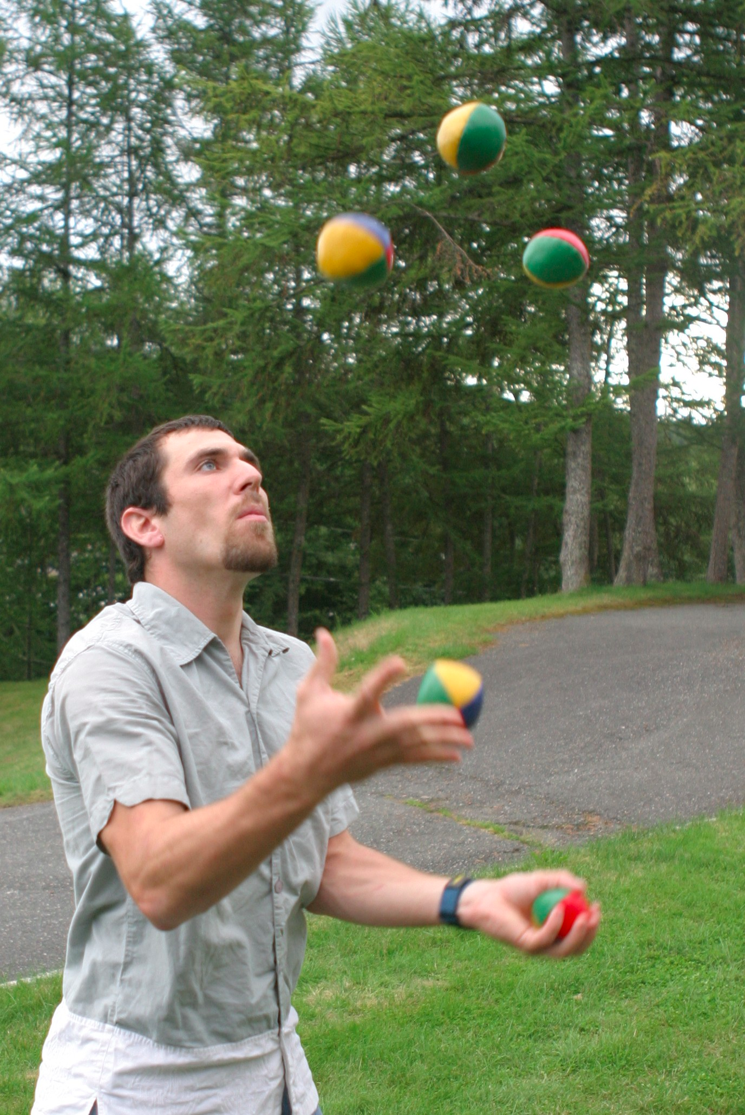
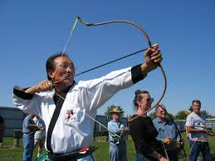
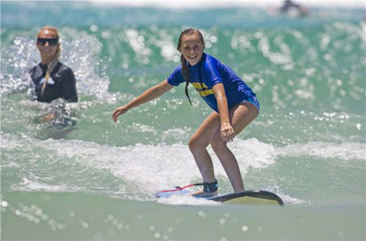
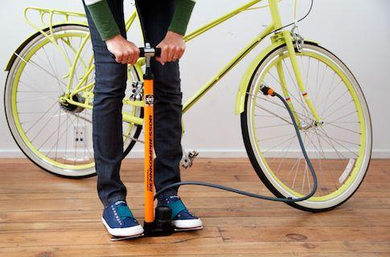
The CCV problem in movement control
(3) A movement depends on muscle force and force environment.
Incidental dynamics
Inertia (swinging a bat) and resistance (writing on paper, pumping a tire)
Potentials: absorb, store and return mechanical energy: gravity (juggling balls) and elastic (bouncing a ball, archery)
Energy sources: other people (dancing) or objects (flying a kite, surfing the wave)

Slide 32
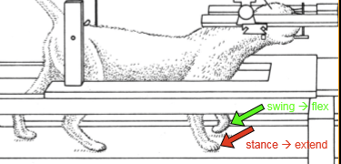
Bernstein’s solution to the CCV problem: Synergy
Low-level automatisms (at the spinal level) automatically adjust for varying conditions
The motor system takes advantages of non-muscular forces
Touch paw during stance → extend
Touch paw during swing → flex

Slide 33
Summary
The Degrees of Freedom problem: too many things to control
Solution: higher-order control variables (or coordination)

Slide 34
Summary
The Context Conditioned Variability problem: neural commands do not uniquely determine movement
Inverse kinematics and inverse dynamics
Muscle state, architecture
Inherent and incidental dynamics
Solution 1: feedback, or closed-loop control – perception is needed to know the state of the action system (e.g. position of a joint)
Solution 2: higher-order control variables; or coordination (don’t need to know the state of each component, only that of the whole system)

Slide 35
Reading
“The Bernstein Perspective I and II” by Turvey, M. T. and colleagues.

